Slide 1


BVRIT HYDERABAD
College of Engineering for Women
Department of Information Technology
Title: GAMING APPLICATION ON ALZHEIMER’S DISEASE DETECTION
Date: 08-06-2023
Team - 7
K.Sanjana Reddy (19WH1A1219)
M.Deepthi Sharvani (19WH1A1220)
R.Rajani (19WH1A1241)
K.Aarthi (19WH1A1258)
Internal Guide:
Dr. Aruna Rao S.L
Professor & HoD
Department of Information Technology

Slide 2
AGENDA
Summary of Stage I
Implementation of Experimental Design
Execution video
Analysis of Results, Discussion
Conclusion and future scope
Department of Information Technology

Slide 3
SUMMARY OF STAGE 1
Registration process is completed
Implemented one game
Department of Information Technology

Slide 4
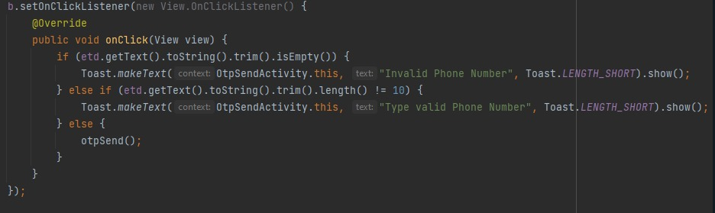
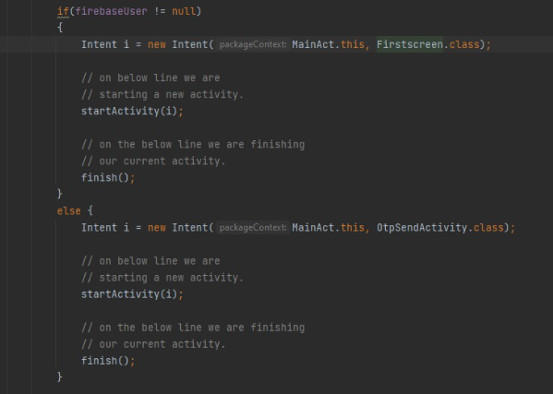
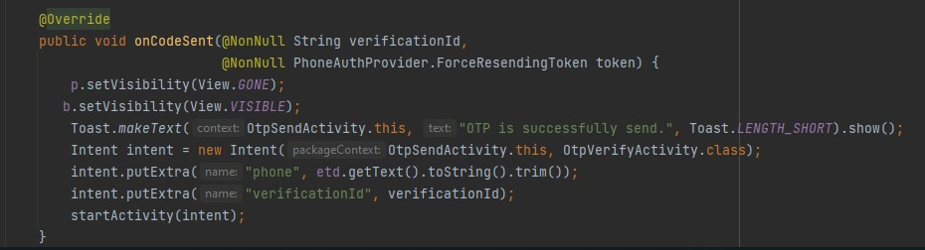
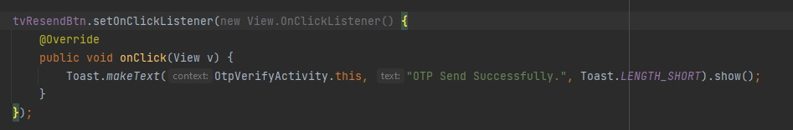
MODULE 1 IMPLEMENTATION
1. Registration
Department of Information Technology

Slide 5
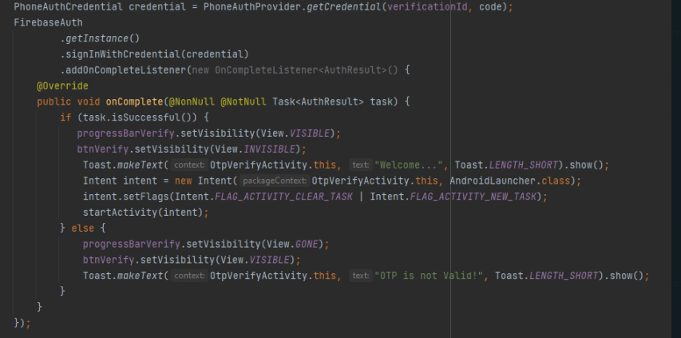
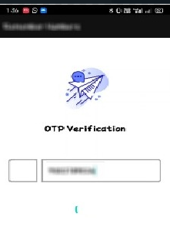
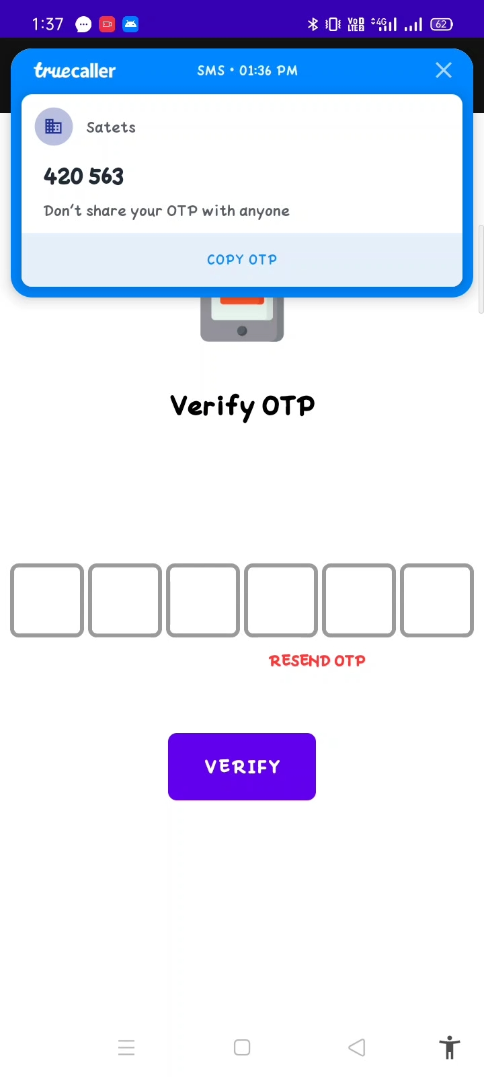
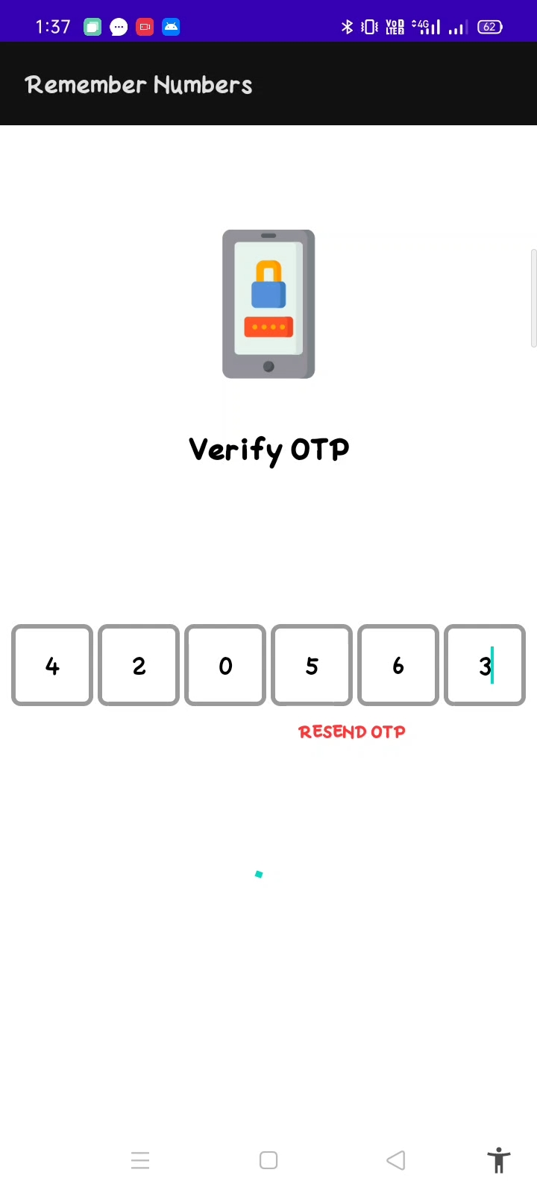
Department of Information Technology

Slide 6
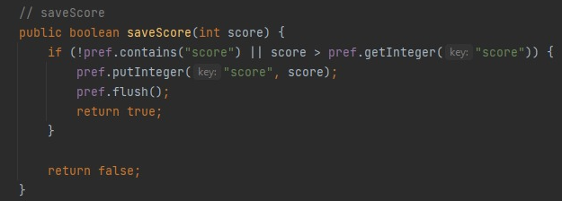
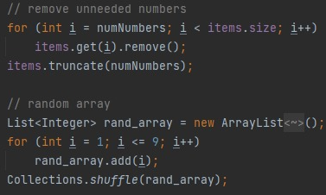
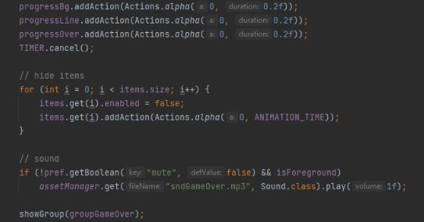
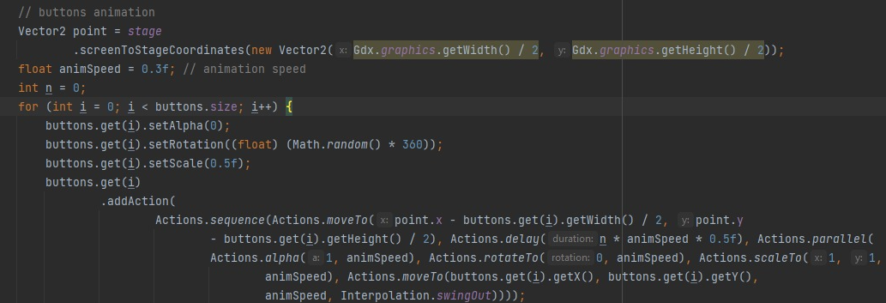
MODULE 2 IMPLEMENTATION
2.Number sort
Department of Information Technology

Slide 7
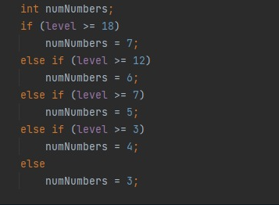
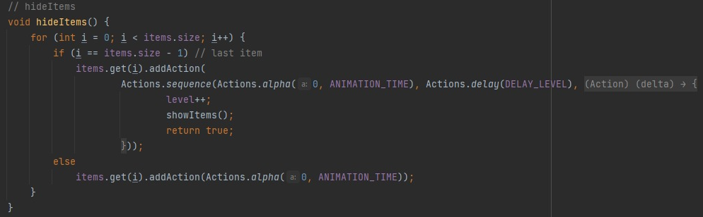
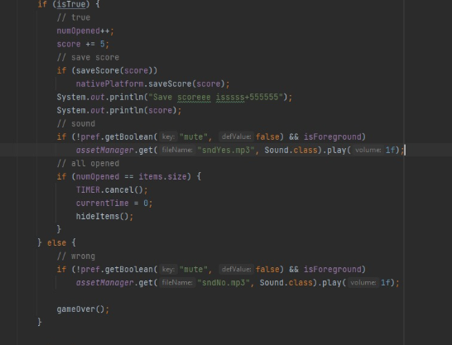
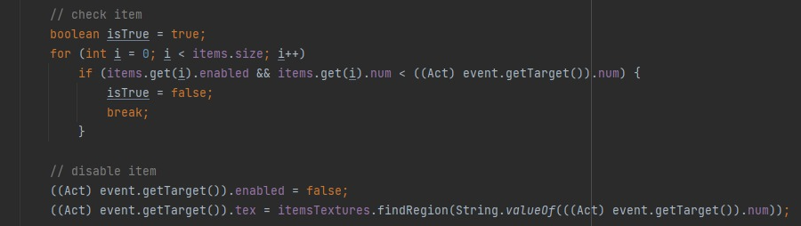

Slide 8
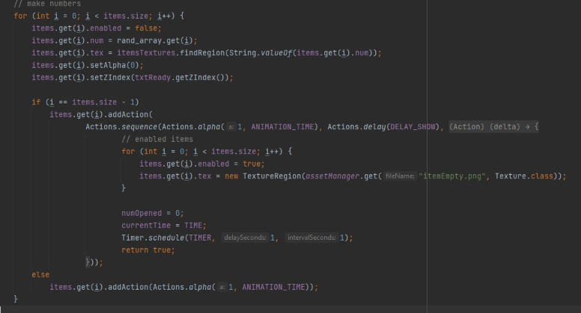
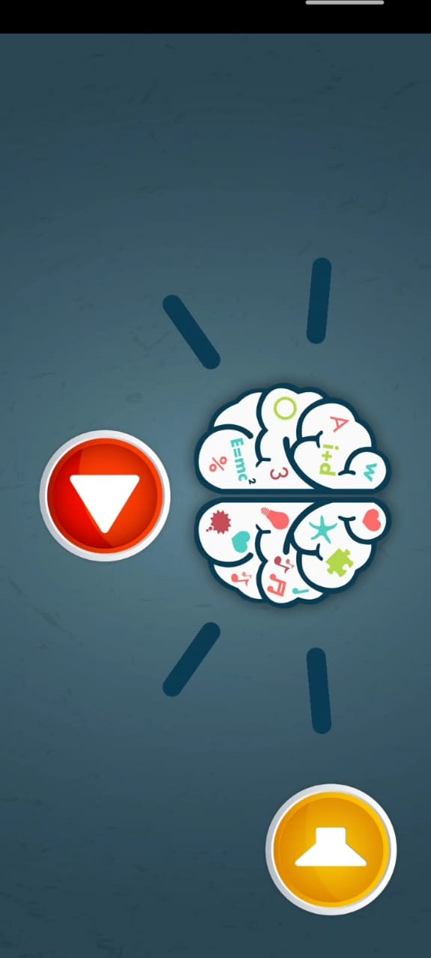

Department of Information Technology

Slide 9
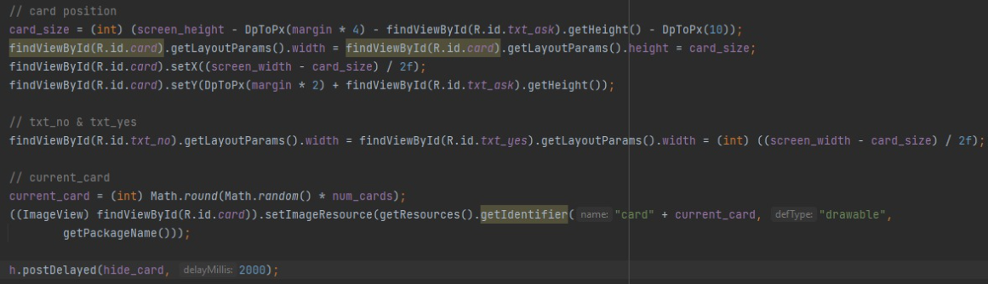
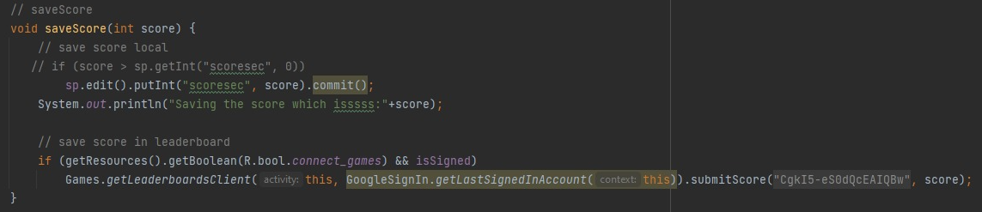
MODULE 2 IMPLEMENTATION
2. Does the card match or not?
Department of Information Technology

Slide 10
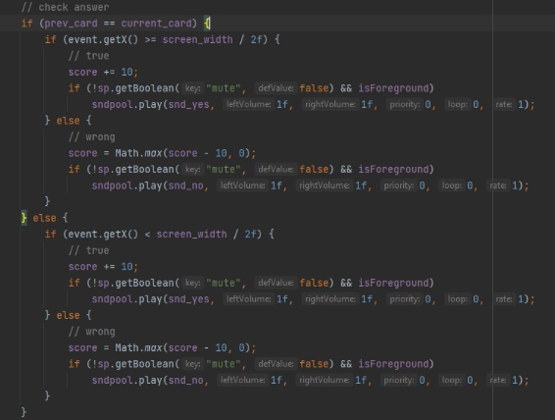
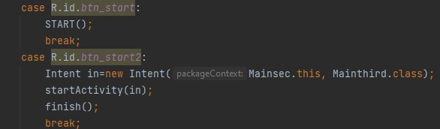
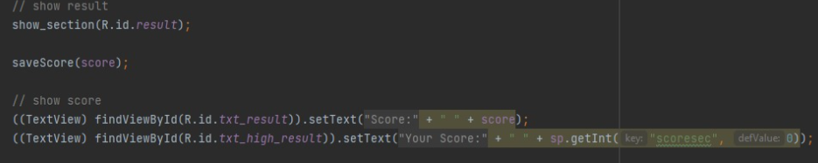
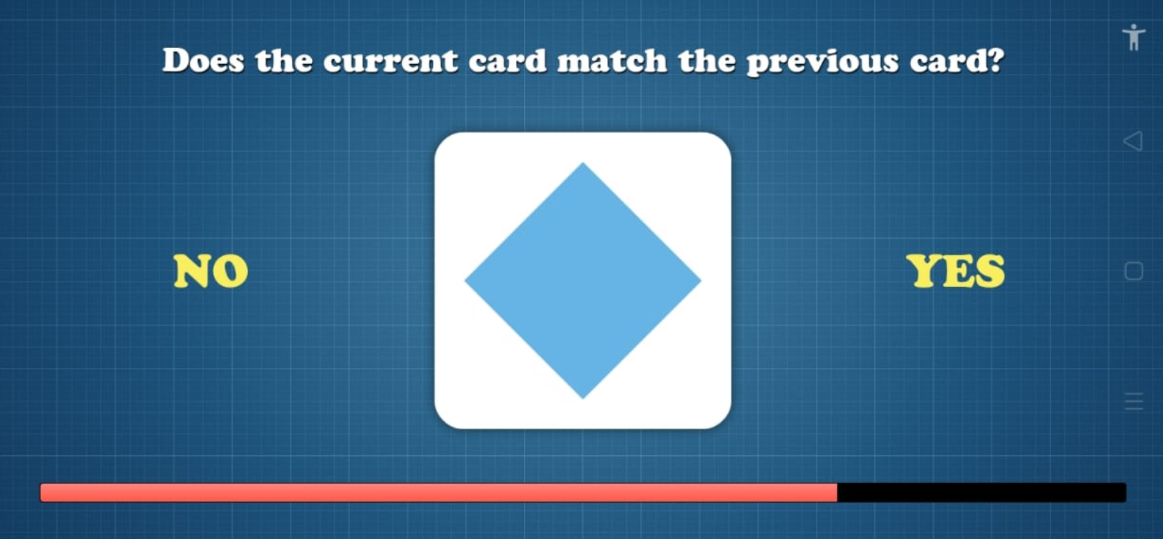
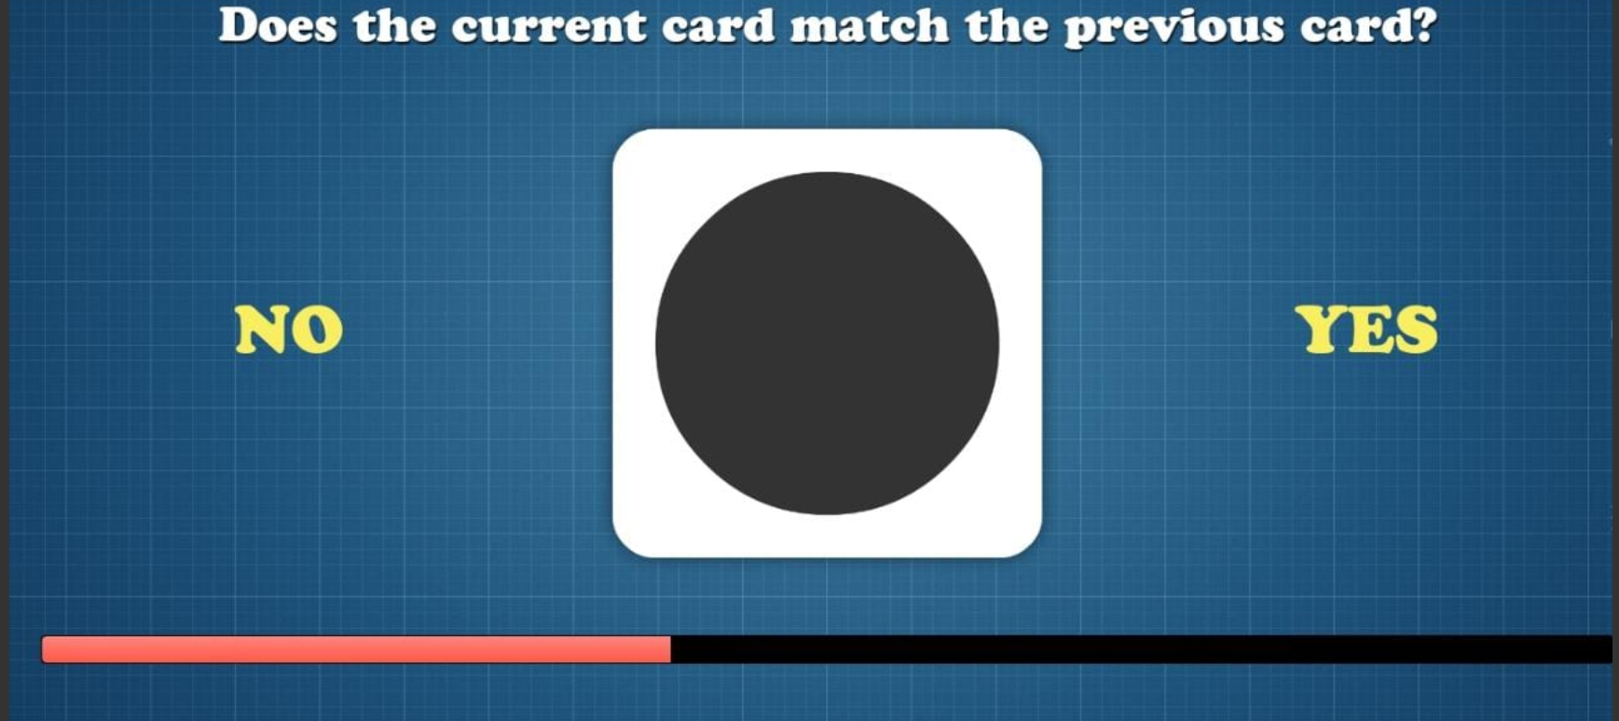

Slide 11
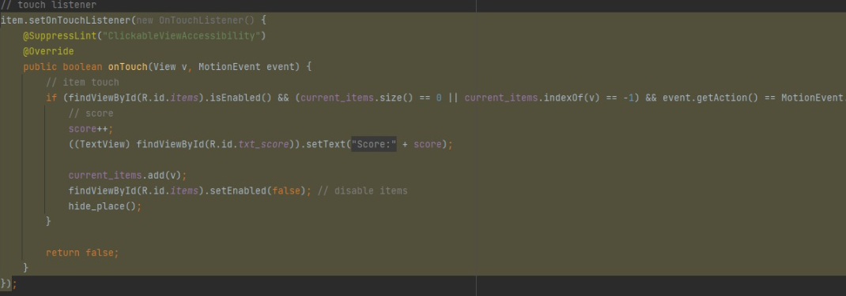
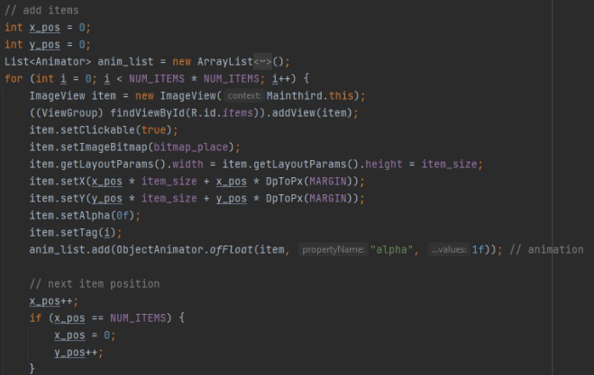
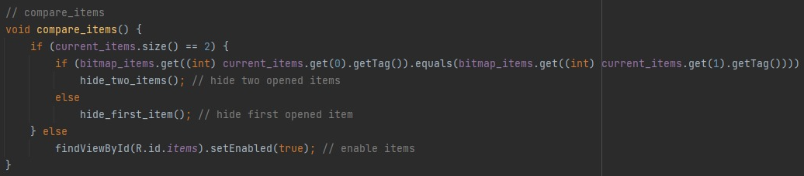
MODULE 2 IMPLEMENTATION
3.Matching game
Department of Information Technology

Slide 12
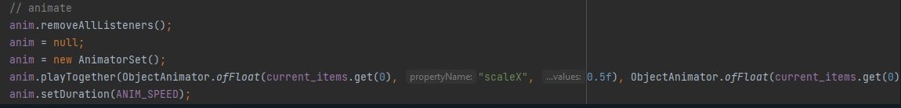
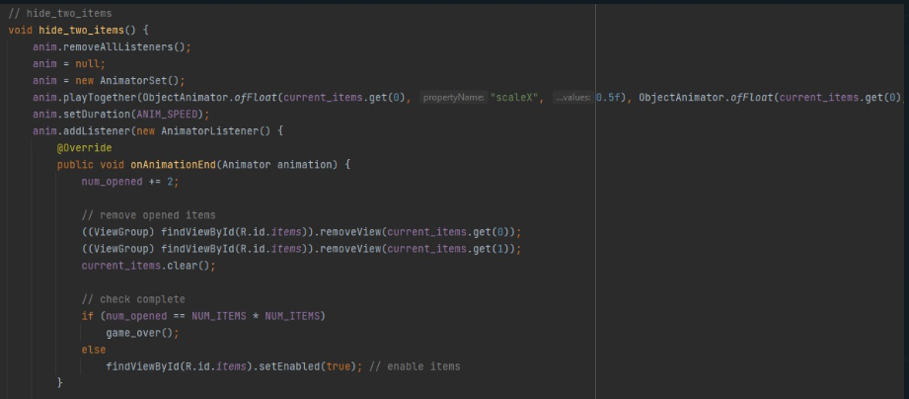
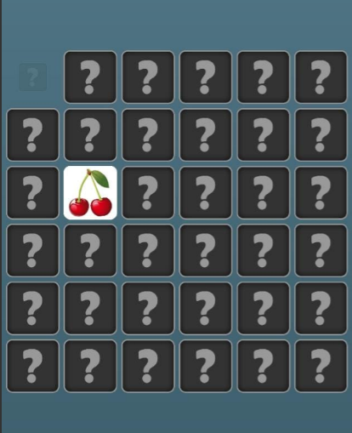
Department of Information Technology

Slide 13
MODULE 3 IMPLEMENTATION
Game | Age | Number of people | Score Range | observation
Number Sort | 45 - 75 | 22 | 75 - 450 | A normal person is able to remember the numbers at max till 7 circles.
Does card match or not? | 45 - 75 | 22 | 90 - 300 | 1 - 2 seconds per tap
Matching game | 45 - 75 | 22 | 130 - 280 | For a normal people initially when all the cards are unmatched, it takes more moves but when the number of cards keep reducing, we can complete with least moves
Department of Information Technology

Slide 14
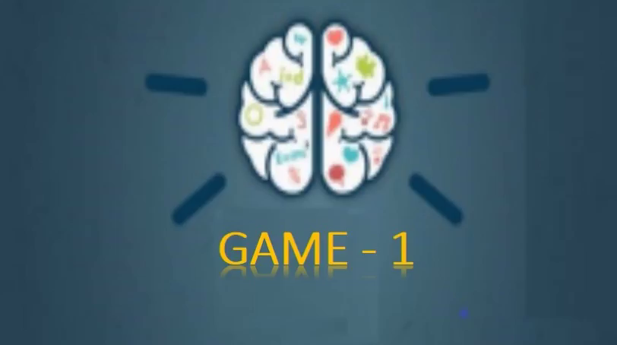
EXECUTION VIDEO
Department of Information Technology

Slide 15
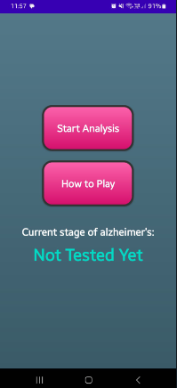
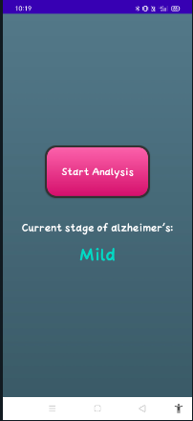
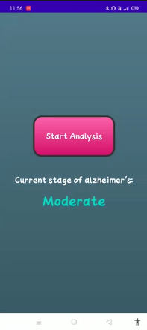
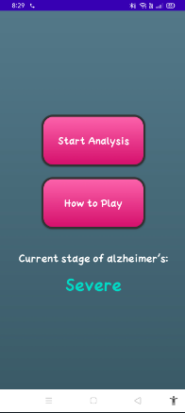
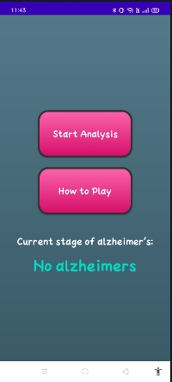
ANALYSIS OF RESULTS , DISCUSSION
Department of Information Technology

Slide 16
CONCLUSION AND FUTURE SCOPE
People never prefer to visit doctor until the symptoms get intensified, which generally happens in later stages of disease.
CT scans, MRI scans and PET scans are performed when prescribed by doctor only. Hence diagnosing the disease and providing the proper medication for the patient in early stages of disease, will help in preventing the serious effects caused by the disease in later stages.
The mobile applicion developed will help to diagonize the disease in early stage by playing the games.
Along with diagonizing of disease, we can provide the games to improve the patients thinking skills and memory power.
We can exted the application by providing the medication for the disease, and by helping the patient to get doctor appointments in the required situations.
Department of Information Technology

Slide 17
THANK YOU
Department of Information Technology

